Slide 1

4. YAHUSU BIOLOGY YA:
UGONJWA WA MALARIA
kibui kago
Notes:
23.15
MURIEGA! THENGIU MUNO NIGUUKA GUUKU GUTHIKIRIRIA MAUNDU MAKONII CELL BIOLOGY.
TWARAGIA UHORO WA MIRIMU TONDU MIRIMU ITHOOKAGIA MAUNDU GWA CELLS CIITU!
KUOGWO TUREERUTA UHORO WA CELL BIOLOGY TUKIARAGIA UHORO WA MIRIMU.
UMUUTHI TURAARIA UHORO WA MALARIA. IYO TURARIRIE UHORO WA CANCER.

Slide 2
Watu
Notes:
6:50
KINDU TUUGAGA GUKU MUNO TUKIARIA UHORO WA MIRIMU, NIATI ITHU TA ANDU

Slide 3

Watu
Notes:
3:05
TUTHONDEKETWO NA ORGANS TOFAUTI

Slide 4
Watu
Notes:
3:80
NA ORGANS CITHOONDEKETWO NA CELLS

Slide 5
Watu
Notes:
4:20
NA CELLS ICI CITHOONDEKETWO NA MOLECULES

Slide 6
Watu
Notes:
10:35
NA MOLECULES CIGATHONDEKWO NA ATOMS. GITHE TIGUO??
NA NITUUGITE ATI MIRIMU ITHOGOTHANAGIA CELLS, KUOGWO MALARIA iGUTHOGOTHANIA ATIA?

Slide 7
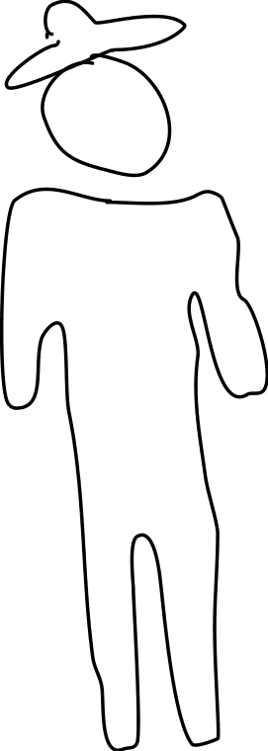
kibui kago
Notes:
4:39
MURIMU UYU UREHAGWO TWARUMWO NI RWAGE.

Slide 8
NGOZI YETU
kibui kago
Notes:
8:20
NO KIRIA GITURWARAGIA TI RWAGE, NI TUNYAMU TUIKARAGA THIINI WA RWAGE TWIITAGWO PLASMODIUM.

Slide 9
Plasmodium vivax
Plasmodium falciparum
Plasmodium ovale
Plasmodium malariae
PLASMODIUM KNOWLESI
NGOZI YETU
kibui kago
Notes:
4:53
NA KWI MITHEMBA EETAANO YA PLASMODIUM ICI.

Slide 10
Plasmodium falciparum
NGOZI YETU
kibui kago
Notes:
10:03
NERIA ITURWARAGIA GUKIRA ICIO INGI IITAGWO PLASMODIUM FALCIPARUM.
RIU PLASMODIUM ITURWARAGIA ATIA HIIHI??

Slide 11
SPOROZOITE
kibui kago
Notes:
22:80
MUNDU AARUMWO NI RWAAGI, TUPLASMODIUM TUKAINGIRA TONDU TUKORAGWO MATA-IN MA RWAGI
TWI MATA-INI MA RWAGI, RI TWITAGWO “SPOROZOITE”. NA RITWA RIRI NIKUUGA RIIKA RIA TUPLASMODIUM TUTU.

Slide 12
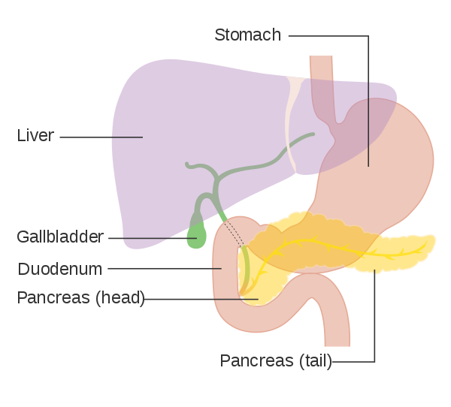
NGOZI YETU
kibui kago
Notes:
5:24
TWAINGIRA THAKAAME, RI, TUTHIIAGA KWI INI.

Slide 13
SCHIZONT
NGOZI YETU
kibui kago
Notes:
14:46
TWAINGIRA HAHA THIINI WA INI, TUIKARAGA TA CIUMIA IGIRI. IHIINDA RIRI, NOTURAAKURA NA KWIGAYANIA.. NA RIIKA RWATUO HAHA, RWITAGWO SCHIZONT

Slide 14
SCHIZONT
NGOZI YETU
kibui kago
Notes:
4:29
TWI THIINI WA INI, RI, NOTURAKUURA NATUKAINGIHA.

Slide 15
SCHIZONT
NGOZI YETU
kibui kago
Notes:
14:00
TWAIYURA, TUGAATURA CELLS CIA INI KUOGWO INI RIKARWARA.
TUPLASMODIUM RIU, NITWOIMA INI, NATUKAINGIRA CELLS NDUUNE CIA THAKAME CIITAGWO RED BLOOD CELLS.

Slide 16
merozoite
NGOZI YETU
kibui kago
Notes:
12:46
TUPLASMODIUM TWAINGIRA CELLS NDUNE CIA THAKAME (KANA RED BLOOD CELLS), NITUCENJAGIA HANIINI GUKIRA URIA TURAARI,
NA HAHA, TUINGERAGA RIIKA RIITAGWO MEROZOITE

Slide 17
NGOZI YETU
kibui kago
Notes:
2:55
TWI THIINI WA RED BLOOD CELLS,

Slide 18
Pf. Emp1 PROTEINs
NGOZI YETU
kibui kago
Notes:
13:93
KINDU KIMWE Tuplasmodium tWIIKAGA NI GUTHOONDEKA PROTEINS CIA GUTHOGOTHANIA RED BLOOD CELLS. IMWE CIA PROTEINS ICI, NI CIA FAMEREE IITAGWO PFEMP1.
.

Slide 19
Pf. Emp1 PROTEINs
NGOZI YETU
kibui kago
Notes:
6:24
PROTEIN INO ITUMAGA CELLS ICI CIA THAKAME CIKANYIITANA MUNO.

Slide 20
Pf. Emp1 PROTEINs
NGOZI YETU
kibui kago
Notes:
47:60
CIANYIITANA RI, CIKAIYURA NJIRA YA RED BLOOD CELLS, NA GUGAKORWO NA THIINA YA THAKAME GUTHII KURIA YAAGIRIIRE
TAIMAGINI WE UGITHII KUNDU NA ANDU MAKAIYUURA NJIRA MBERE YAAKU… GITHE NDUKUREMWO NIGUTHII NAMBERE? OO UUU, THAKAME NDIHOTAGA GUTHII KURIA YAAGIRIIRE KUOGWO UUU NIGUO RIMWE ANDU MAKORAGWO NA ORGAN FAILURE.. TONDU THAKAME NDIRAKINYA ORGANS IRIA YAAGIRIIRE.
KINDU KIINGI CIIKAGA NICINYIITANAGA NA RUTHINGO RWA NJIRA YA THAKAME (kana blood vessel) NA CIKEEHITHA KUUMA IMMUNE SYSTEM. KUOGWO CELLS CIA IMMUNE SYSTEM CIOKA GUCARIA TUPLASMODIUM CIKAREMWO

Slide 21
NGOZI YETU
kibui kago
Notes:
32.39
O CIGETHOONDEKAGA PROTEIN INGI CIAGOTHOGOTHANIA RED BLOOD CELLS, TUPLASMODIUM NOOTURAAKURA, NA TUKAIYURA RED BLOOD CELLS GINYA CIGAATUKA.
MAUNDUI-INI MAYA MOOTHE, RI, RED-BLOOD CELLS CITIHOTAGA KURUTA WIIRA WACIO WEEGA, NA TONDU NICIO CIKUUAGA OXYGEN THIINI WA CELLS CIITU, NIKIO MUNDU AKORAGWO EE MUNOGU MUNO.
TUPLASMODIUM TUU TWOIMA RED blood cells twathii kuu tondu riu cells niciatuka ?
- microcirculation obstruction, impaired tissues perfusion, lactic acidosis and consequently, end-organ damage

Slide 22
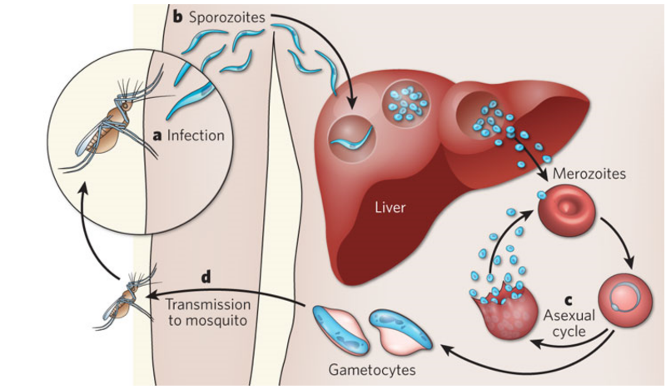
Toppr.com
kibui kago
Notes:
11:02
KE TURORE MBICA INO
TUPLASMODIUM TWA RIIKA RIA MEROZOITE TUGACHEENGIA HANIINI NIGWEETHA TUHOTE GUTHONDEKA PLASMODIUM IINGI, na haha ciitagwo gametocytes

Slide 23
Toppr.com
kibui kago
Notes:
47:01
- KUUMA HAHA, NIGWETHA TUPLASMODIUM TUKURE MAKERIA, NOMUHAKA TUKORWO TWI THIINI WA RWAGI.
- RWAGI RWANYUA THAKAME YA MUNDU MURWARU, RUNYUANAGIRIA NA TU-PLASMODIUM TUU TWETA gametocyte.
- TWI RWAGE-ini,TUGAKURA, TUKEEGAYANIA, NA TUGACOOKA GWA RIIKA RIA SPOROZOITE.
NIURARIRIKANA TUGIRE ATI RIIKA RIA SPOROZOITE NIGUO CIANJAGIA KUINGIRA ANDU? IHINDA RIRI-RI, TUKWANJIA CYCLE INO RIINGI.
UCIO NIGUO UHORO WA URIA MURIMU WA MALARIA UTURWARAGIA..ANGIKORWO WIINA CIURIA, KANA MURIMU URENDA KUIGWA UHORO WAGUO, ANDIKA HA COMMENTS! NA TINDA NA THAYU ☺

Slide 24
ANGALIA PIA:
PICHA: Toppr.com: https://www.toppr.com/ask/question/which-one-of-the-following-is-not-a-site-ofaction-in-a-human-body-for/
Zekar, Lara, and Tariq Sharman. "Malaria (Plasmodium Falciparum)." StatPearls [Internet]. StatPearls Publishing, 2020.
Center for disease control (CDC) malaria
https://www.cdc.gov/malaria/about/biology/index.html
PICHA ya liver: wikipedia
kibui kago

